Slide 1

Adding scope name in front of variable name - tf.variable_scope vs tf.name_scope

Slide 2
Reference
Stackoverflow
Youtube on tf.get_variable
Youtube on tf.variable_scope
Youtube on Sharing Variables
Code

Slide 3
Both scopes have the same effect on all operations as well as variables created using tf.Variable, i.e., the scope will be added as a prefix to the operation or variable name. However, name scope is ignored by tf.get_variable.
stackoverflow

Slide 4
Use tf.variable_scope instead of tf.name_scope. Nothing to lose and you get some extras.

Slide 5
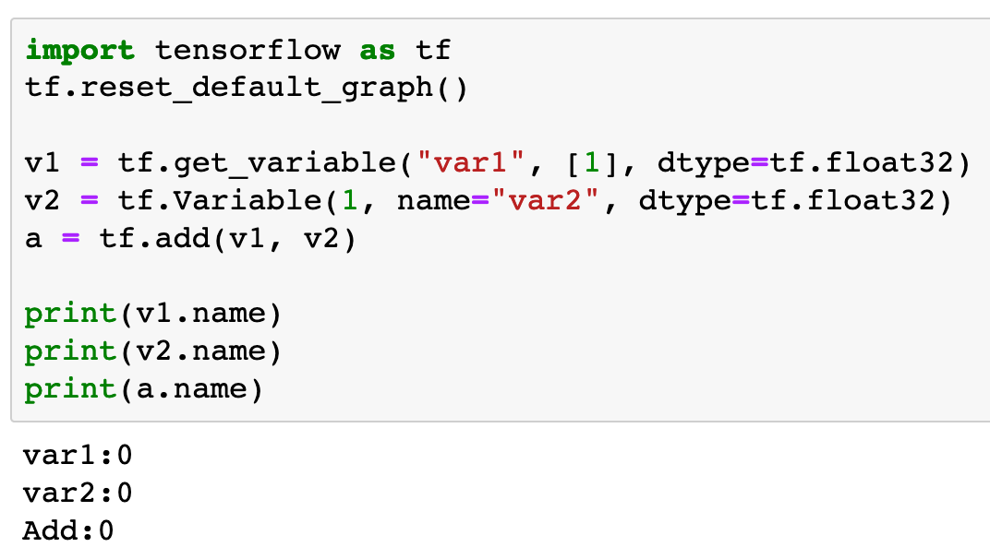


Slide 6
tf.variable_scope is honored by both tf.Variable and tf.get_variable

Slide 7
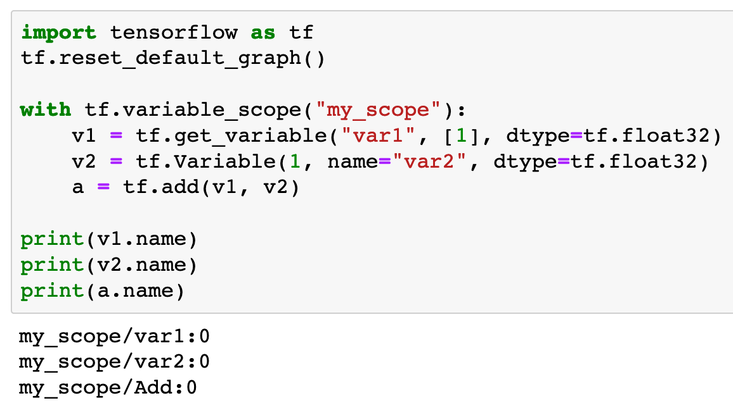

Slide 8
tf.variable_scope is honored by both tf.Variable and tf.get_variable

Slide 9
tf.name_scope is ignored by tf.get_variable

Slide 10
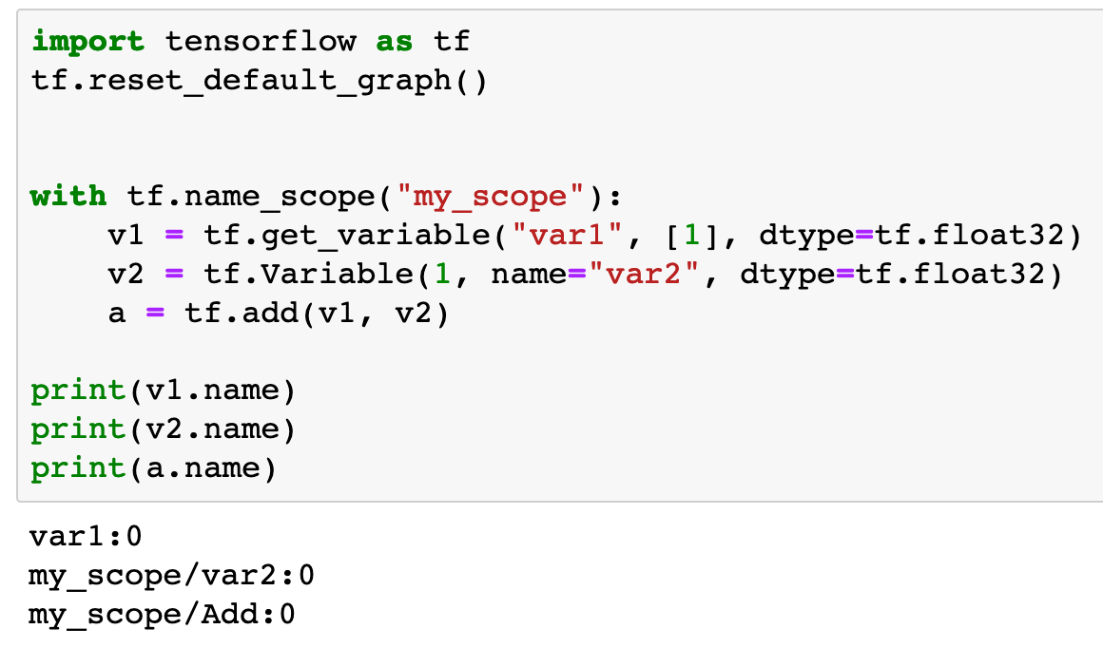

Slide 11
tf.name_scope is ignored by tf.get_variable

Slide 12
Sharing Variables Success!

Slide 13
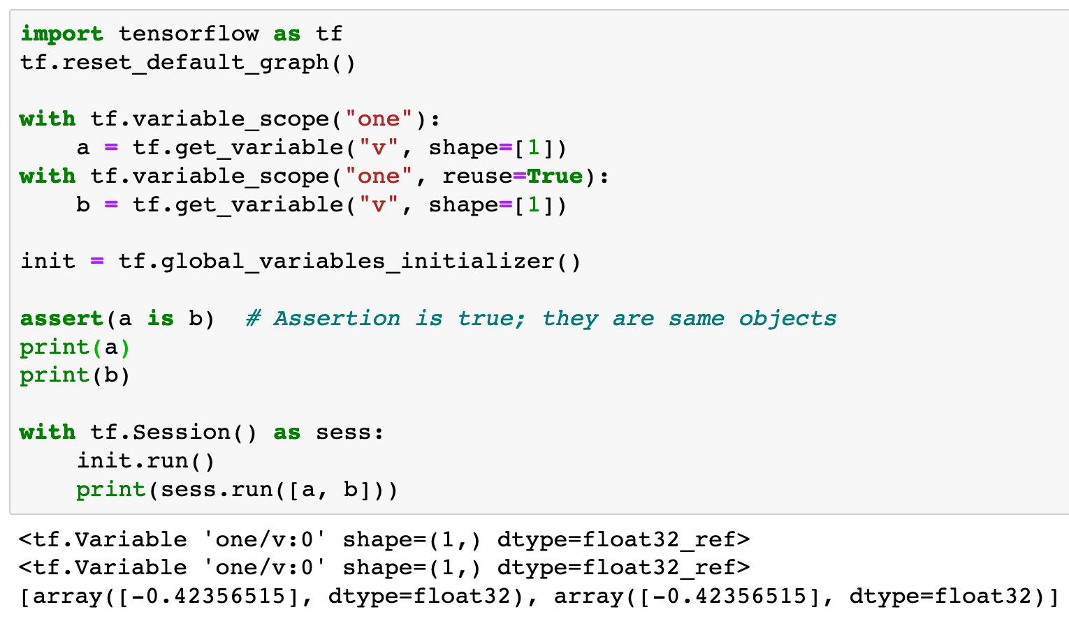

Slide 14
resue=True

Slide 15
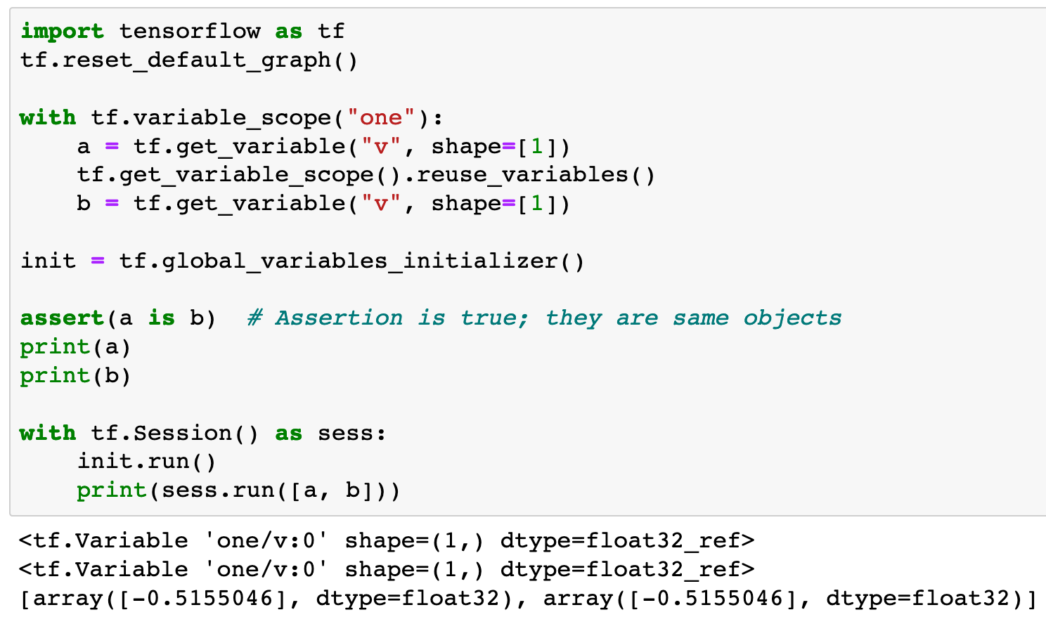

Slide 16
reuse variables
in the same variable scope

Slide 17
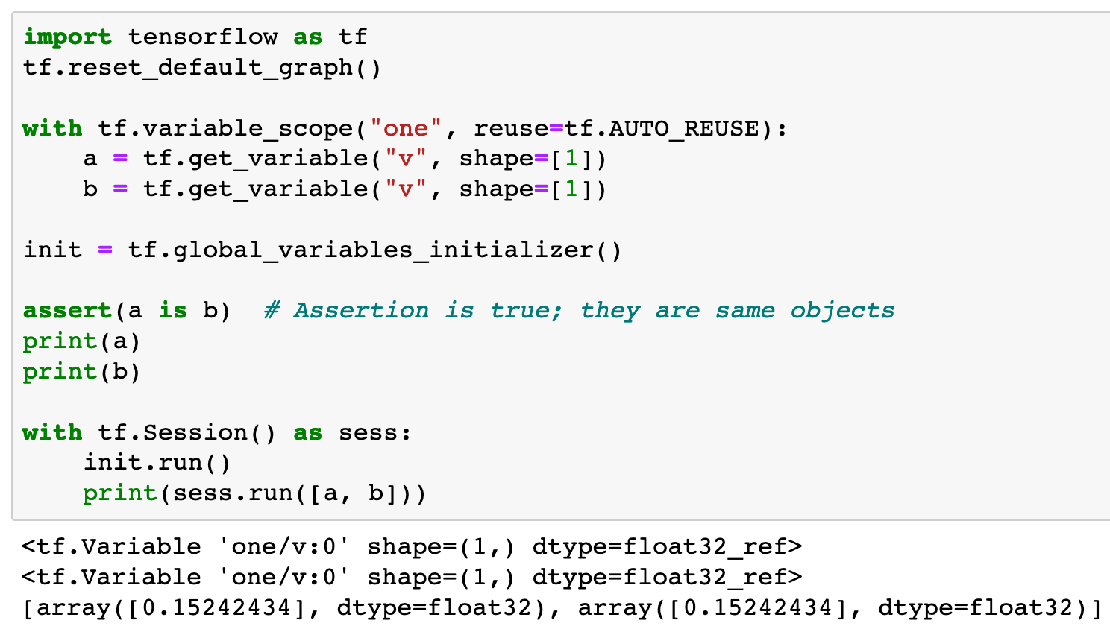

Slide 18
reuse variables
in the same variable scope
automatically

Slide 19
Now
Let’s Play with Code

